Slide 1


Slide 2
Physics For Engineers
NS (110)
Lecture # 17
Date: 7th Oct, 2019

Slide 3
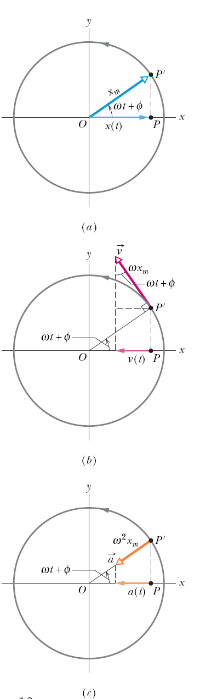

SHM and uniform circular motion
Consider a reference particle P’ moving in uniform circular motion with constant angular speed (w).
The projection of the particle on the x-axis is a point P, describing motion given by:
This is the displacement equation of SHM.
SHM, therefore, is the projection of uniform circular motion on a diameter of the circle in which the circular motion occurs.

Slide 4

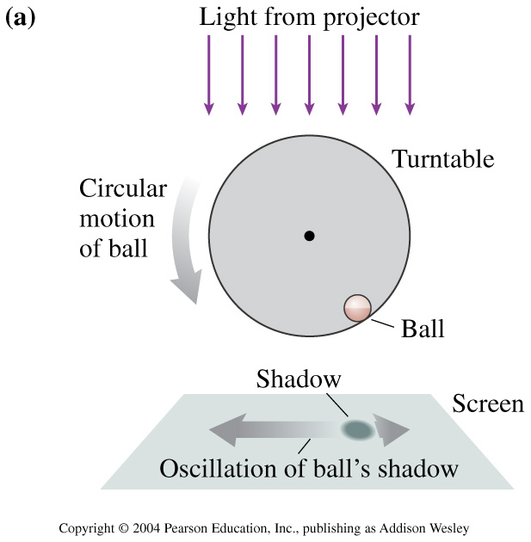
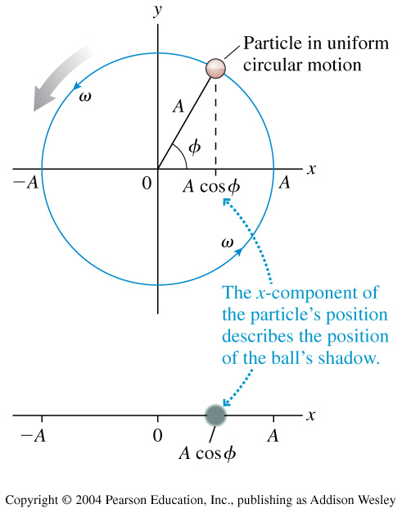
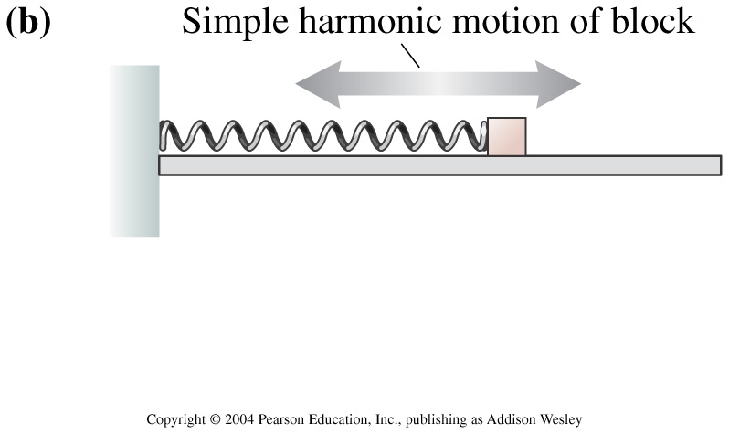
Uniform circular motion can be considered a combination of two simple harmonic motions, one along the x axis and one along the y axis, with the two differing in phase by 90°.
http://surendranath.tripod.com/Applets/Oscillations/SHM/SHM.html

Slide 5
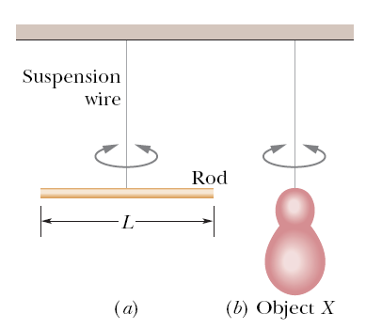
Example, angular SHM:
Figure a shows a thin rod whose length L is 12.4 cm and whose mass m is 135 g, suspended at its midpoint from a long wire. Its period T_{a} of angular SHM is measured to be 2.53 s. An irregularly shaped object, which we call object X, is then hung from the same wire, as in Fig. b, and its period T_{b} is found to be 4.76 s. What is the rotational inertia of object X about its suspension axis?

Slide 6


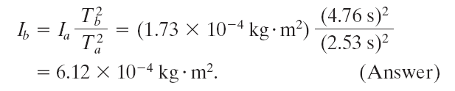
Example, angular SHM:
Figure a shows a thin rod whose length L is 12.4 cm
and whose mass m is 135 g, suspended at its midpoint
from a long wire. Its period T_{a} of angular SHM is measured
to be 2.53 s. An irregularly shaped object, which we
call object X, is then hung from the same wire, as in Fig. b, and its period T_{b} is found to be 4.76 s. What is the
rotational inertia of object X about its suspension axis?
Answer: The rotational inertia of either the rod or
object X is related to the measured period. The rotational inertia of a thin rod about a perpendicular axis through its midpoint
is given as 1/12 mL².Thus, we have, for the rod in Fig. a,
Now let us write the periods, once for the rod and once for object X:
The constant κ, which is a property of the wire, is the same for both figures; only the periods and the rotational inertias differ.
Let us square each of these equations, divide the second by the first, and solve the resulting equation for I_{b}. The result is

Slide 7
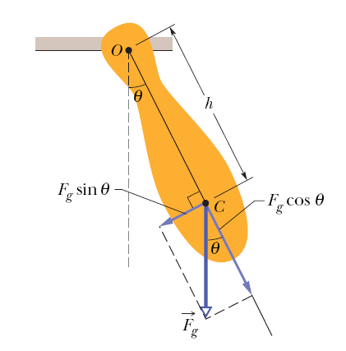
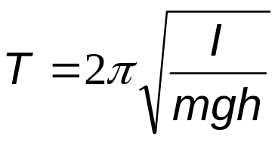
Pendulums
A physical pendulum can have a complicated distribution of mass. If the center of mass, C, is at a distance of h from the pivot point (figure), then for small angular amplitudes, the motion is simple harmonic.
The period, T, is:
Here, I is the rotational inertia of the pendulum about O.

Slide 8
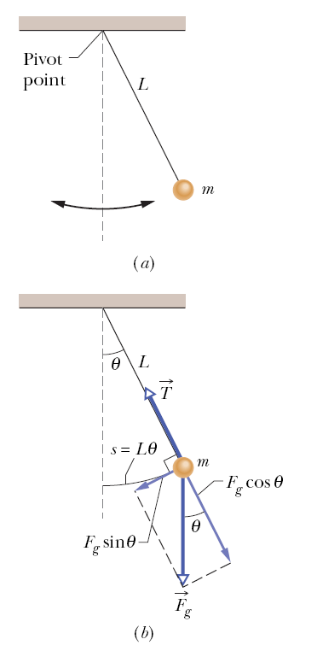
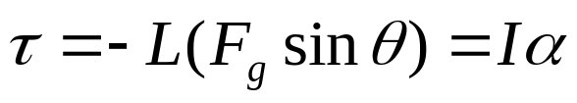
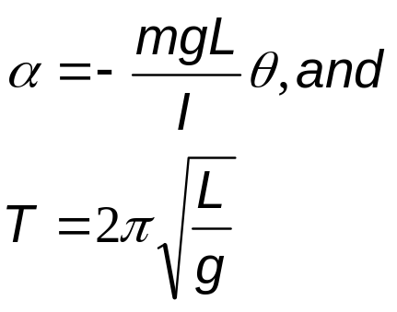
Pendulums
In a simple pendulum, a particle of mass m is suspended from one end of an unstretchable massless string of length L that is fixed at the other end.
The restoring torque acting on the mass when its angular displacement is θ, is:
α is the angular acceleration of the mass. Finally,
This is true for small angular displacements, θ.

Slide 9
Pendulums
In the small-angle approximation we can assume that θ << 1 and use the approximation sin θ ≅ θ. Let us investigate up to what angle θ is the approximation reasonably accurate?
θ (degrees) θ (radians) sin θ
5 0.087 0.087
10 0.174 0.174
15 0.262 0.259 (1% off)
20 0.349 0.342 (2% off)
Conclusion: If we keep θ < 10 ° we make less than 1 % error.

Slide 10
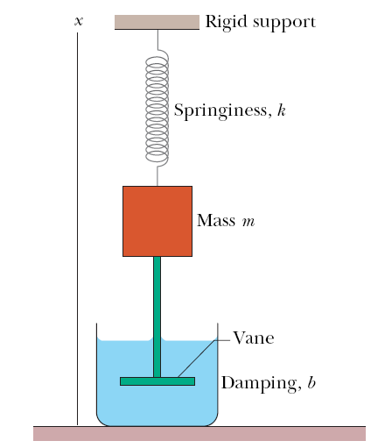
Damped Oscillations
In a damped oscillation, the motion of the oscillator is reduced by an external force.
Example: A block of mass m oscillates vertically on a spring with spring constant k.
From the block a rod extends to a vane which is submerged in a liquid.
The liquid provides the external damping force, F_{d}.

Slide 11
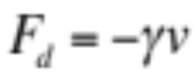
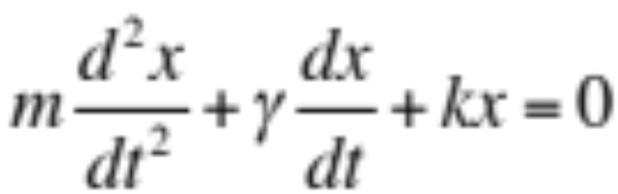
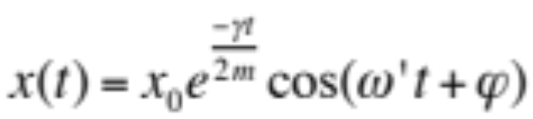
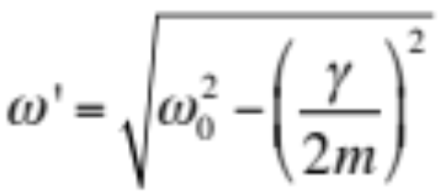
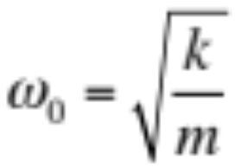
Damped Oscillations
Often the damping force, F_{d}, is proportional to the 1st power of the velocity v. That is,
The solution is:

Slide 12
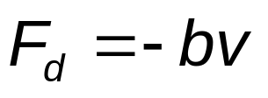
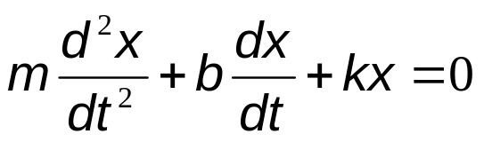
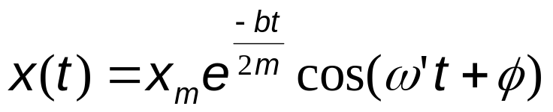
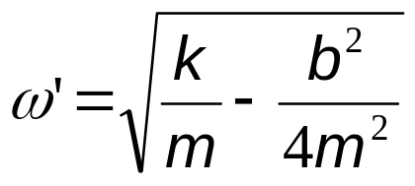
Damped SHM
Often the damping force, F_{d}, is proportional to the 1st power of the velocity v. That is,
From Newton’s 2nd law, the following DE results:
The solution is:
Here ω’ is the angular frequency, and is given by:

Slide 13
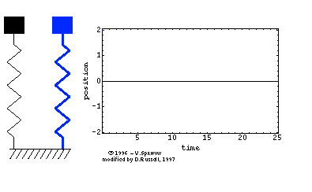
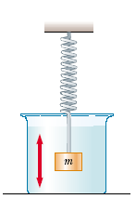
http://www.lon-capa.org/~mmp/applist/damped/d.htm

Slide 14
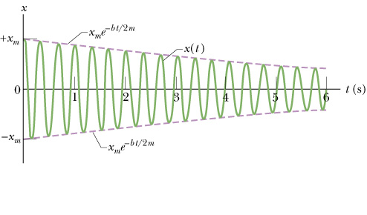
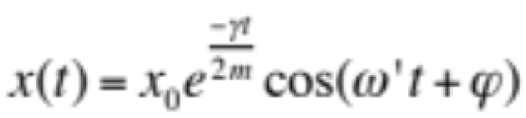
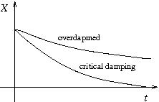
15.5 Damped Oscillations
The above figure shows the displacement function x(t) for the damped oscillator described before.
The amplitude decreases as x₀ exp (-γ t / 2m) with time.
# The above is for γ < 2mω₀ (underdapmed).
# For γ > 2mω₀ (overdapmed)
and γ = 2mω₀ (critical damping),
the oscillation goes like the right
figure.

Slide 15
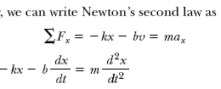


In many real systems, dissipative forces, such as friction, retard the motion.
Consequently, the mechanical energy of the system diminishes in time, and the
motion is said to be Damped.
Retarding force
http://www.lon-capa.org/~mmp/applist/damped/d.htm

Slide 16
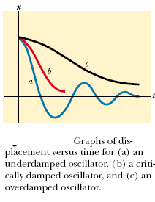

Slide 17
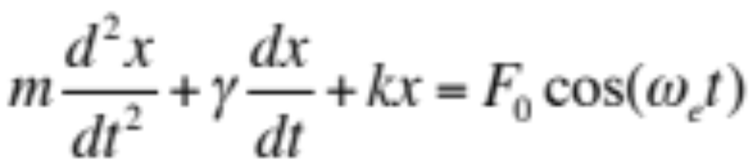
Forced Oscillations and Resonance
When the oscillator is subjected to an external force that is periodic, the oscillator will exhibit forced/driven oscillations.
There are two frequencies involved in a forced oscillator:
w₀, the natural angular frequency of the oscillator, without the presence of any external force, and
w_{e}, the angular frequency of the applied external force.
The equation of motion is like the following:

Slide 18
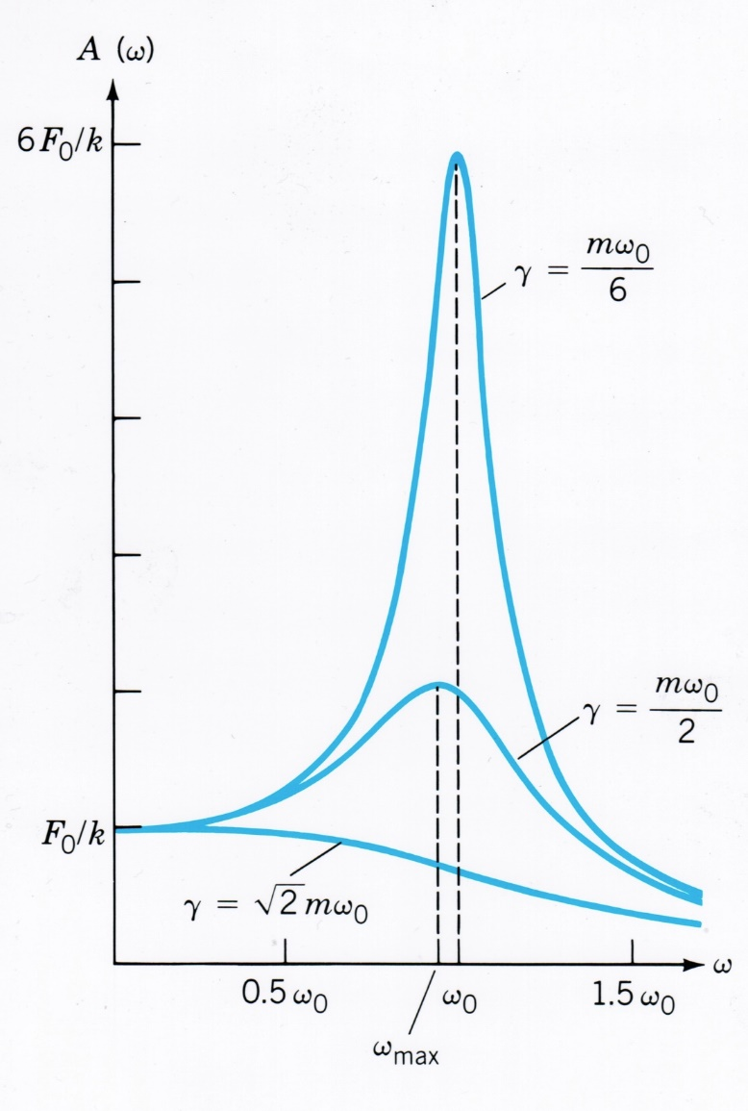
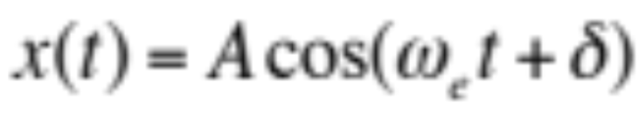
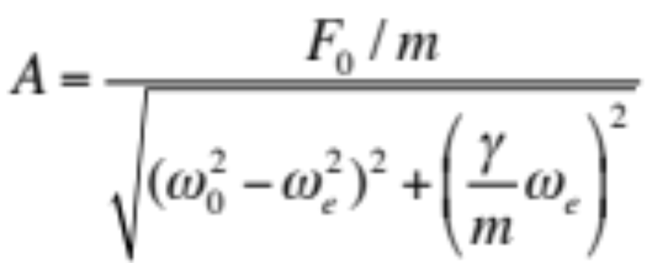
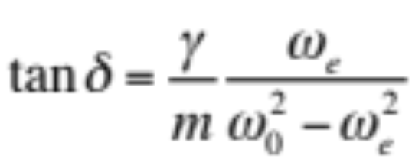
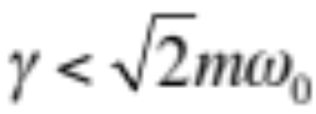
Forced Oscillations and Resonance
The steady state solution is
Resonance occurs at
ω_{e} ~ ω_{max} < ω₀ , for

Slide 19


Example (Mass-Spring System)
Periodic driving
force of freq. f
Oscillating with
natural freq. f_{o}

Slide 20
Resonance
When a system is disturbed by a periodic
driving force which frequency is equal to
the natural frequency ( fo ) of the system,
the system will oscillate with LARGE
amplitude.
Resonance is said to occur.
http://www.acoustics.salford.ac.uk/feschools/waves/shm3.htm

Slide 21

Example 1
Breaking Glass
System : glass
Driving Force :
sound wave

Slide 22



Slide 23


Example 2
Collapse of the Tacoma Narrows
suspension bridge in America in 1940
System : bridge
Driving Force :
strong wind

Slide 24
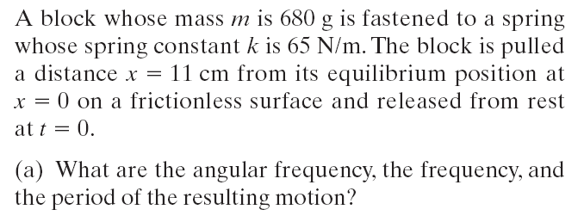
Example

Slide 25
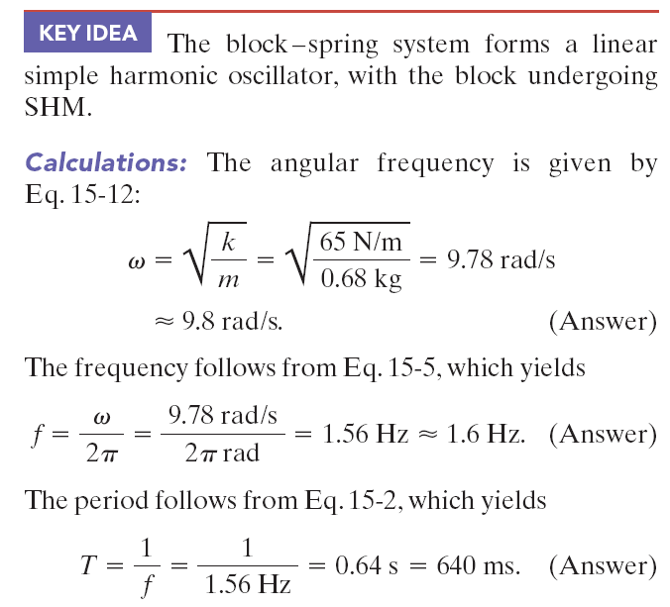

Slide 26
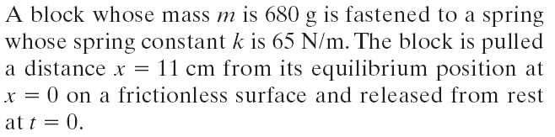
Example

Slide 27
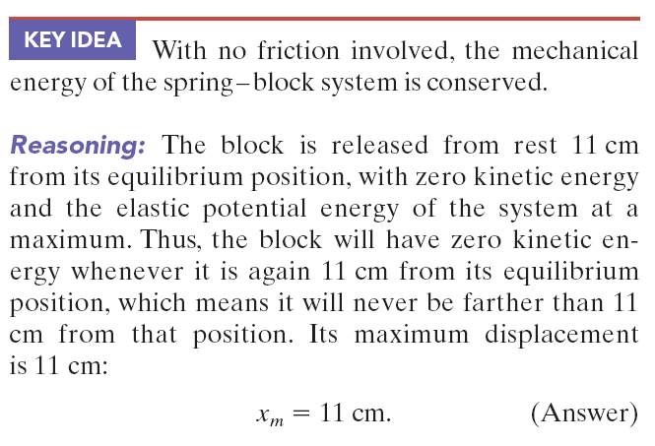

Slide 28
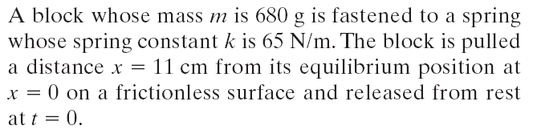

Example

Slide 29

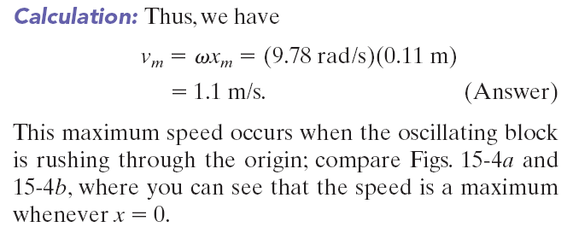

Slide 30
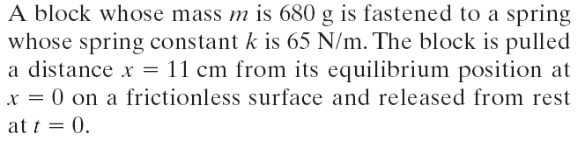

Example

Slide 31
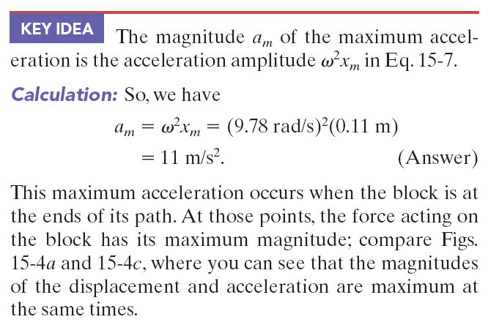

Slide 32
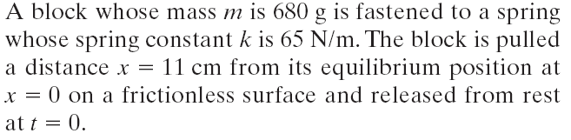
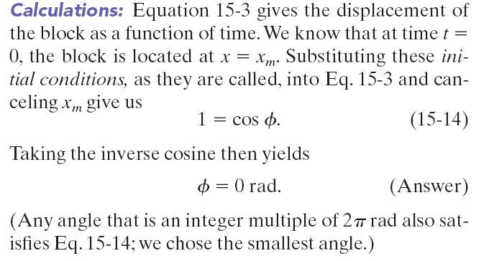
Example

